Slide 1
What is a landing page?
A page whose primary purpose is to help users understand what they can find in a section and where they can go next.
Should include links to all child pages
May include promotional items like ‘latest event’, ‘join our newsletter’ or ‘complete this survey/forms’.
Surfacing popular content from further down in the section. E.g. Kindy calculator.
Landing pages will have a higher visual hierarchy compared to content pages
Can have a hero image or video/animation to accompany the headline
More graphics/media than content
May provide ‘related links’ for users who arrive in error and are looking for a similar or related area/page.
E.g. High school enrolment vs Kindy enrolment

Slide 2
Types of landing pages
Location in the structure (Lvl 1, lvl 2, lvl 3, etc)
Section size – Large, medium and small.
Large - Lots of child pages that also have child pages, potentially need to split into section
Medium – approximately up to 9 child pages
Small – approximately 1-2 child pages

Slide 3
Structure/sections of landing pages
Heading (mandatory)
Banner (Level 1 mandatory/Level 2-4 optional)
Introduction (mandatory)
Content above tiles (optional)
May included quotes
lists or media (Video/image)
Tiles for all child pages (mandatory)
Content below tiles (optional)
Related links (optional)
Add wireframe to show this structure

Slide 4
Guidelines for use
Portfolio site (QED, ECEC and Education) guidelines may differ due to the large size of the site and depth of content
If images are used in rollups, they must be the same type. Ie if you choose to use icons for one page, all tiles must also use icons.
No asides for landing pages
Article rollup titles should never be truncated

Slide 5
Sections | Level 1 | Level 2 | Level 3 | Level 4
General notes | Prominent visual hierarchy |  | Less visual element
Heading (mandatory) | Text heading | Text heading | Text heading | Text heading
Banner (optional) | Large hero banner - Full width (with option to incorporate with heading 1) | Smaller banner or subtle design element | Simple coloured line or nothing | No banner
Introduction (mandatory) | Keyword rich paragraph giving an overview of what they will find in this section Intro text more prominent than content compared to other level landing pages | Intro text to be differentiated to content text (e.g. slightly larger) | Intro text to be differentiated to content text (e.g. slightly larger) | Intro text to be differentiated to content text (e.g. slightly larger)
Content above tiles (optional) | This may include quotes, lists, media (videos or images), key calls to action/buttons | This may include quotes, lists, media (videos or images), key calls to action/buttons | This may include quotes, lists, media (videos or images), key calls to action/buttons | This may include quotes, lists, media (videos or images), key calls to action/buttons
Child page tiles (mandatory) | 3 column layout – stacked or inline Must have images for each page Large sections: Stacked separated with heading 3 titles Priority pages stacked 3 col with sub pages 2 col inline Preferred: xxx | Smaller child page tiles 2 col inline tiles Larger sections: 2 col inline grouped with headings Images optional Preferred is XXXX | Images optional Simple design treatment (e.g. coloured line) | Simple design treatment (e.g. coloured line) Simple outline
Content below tiles (optional) | This may include quotes, lists, media (videos or images), key calls to action/buttons | This may include quotes, lists, media (videos or images), key calls to action/buttons | This may include quotes, lists, media (videos or images), key calls to action/buttons | This may include quotes, lists, media (videos or images), key calls to action/buttons
Related links (optional) | Additional supporting links Links list Tiled links | Additional supporting links Links list Tiled links | Additional supporting links Links list Tiled links | Additional supporting links Links list Tiled links

Slide 6
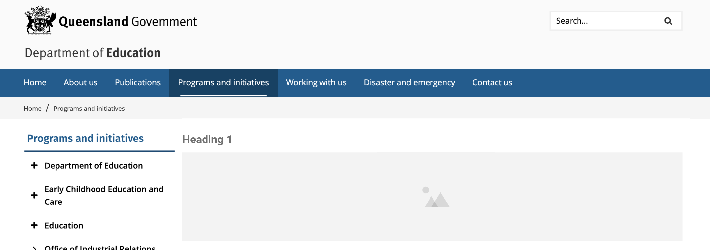
Heading (mandatory) & Banner (optional)
Level 1
Level 2
Level 3
Level 3/4

Slide 7
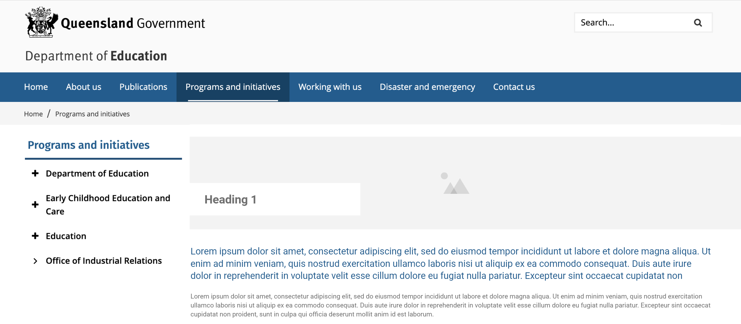
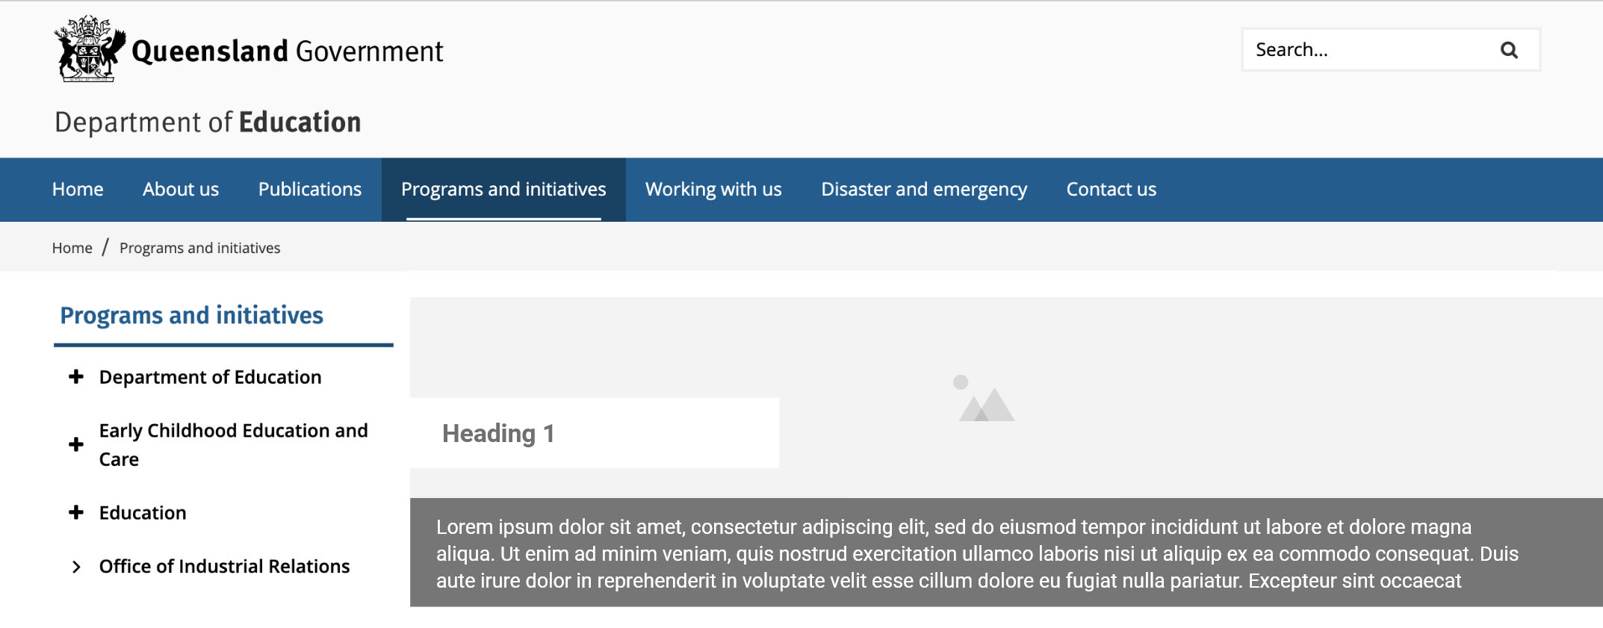
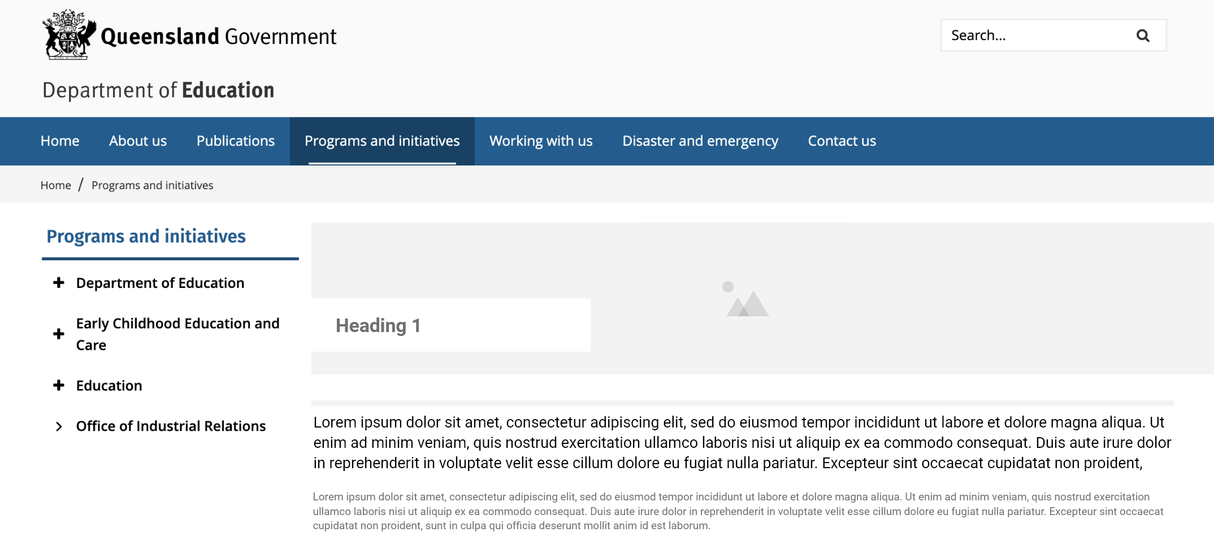
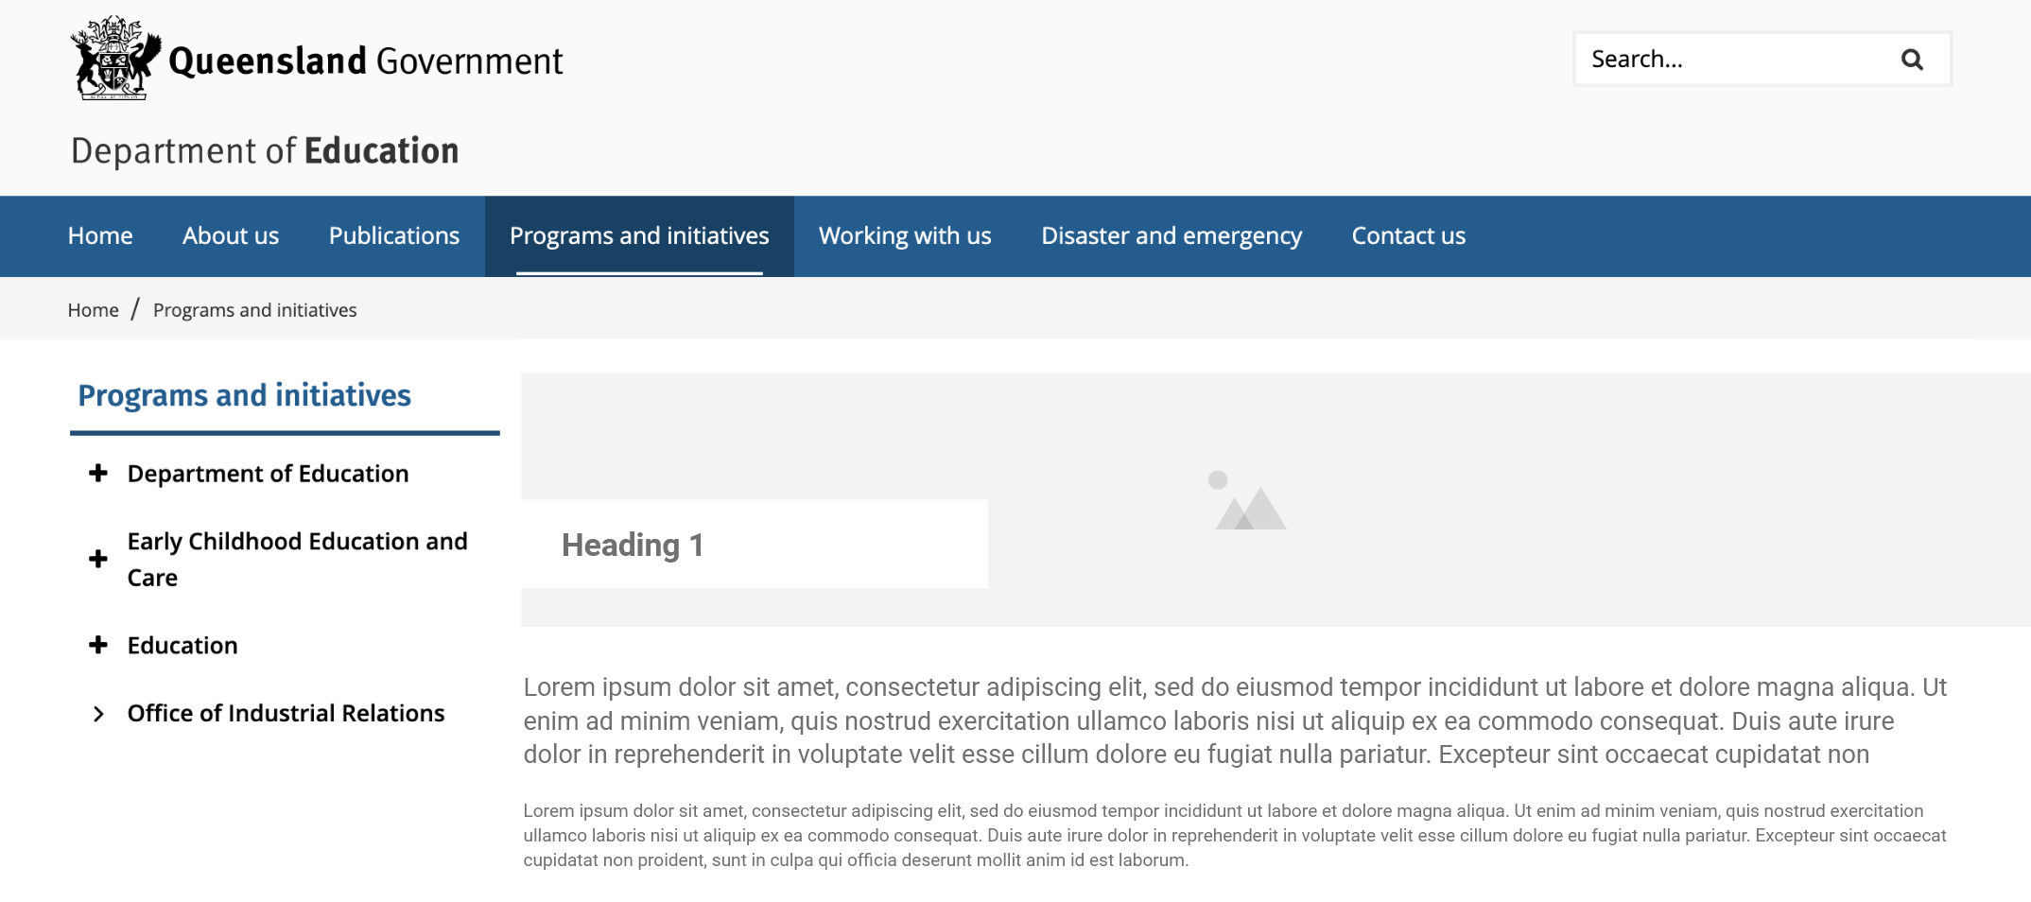
Introduction (mandatory)
Level 1
Level 2/3/4
Is this example for level 1?
Please update example to page 2, 3 or 4 header

Slide 8
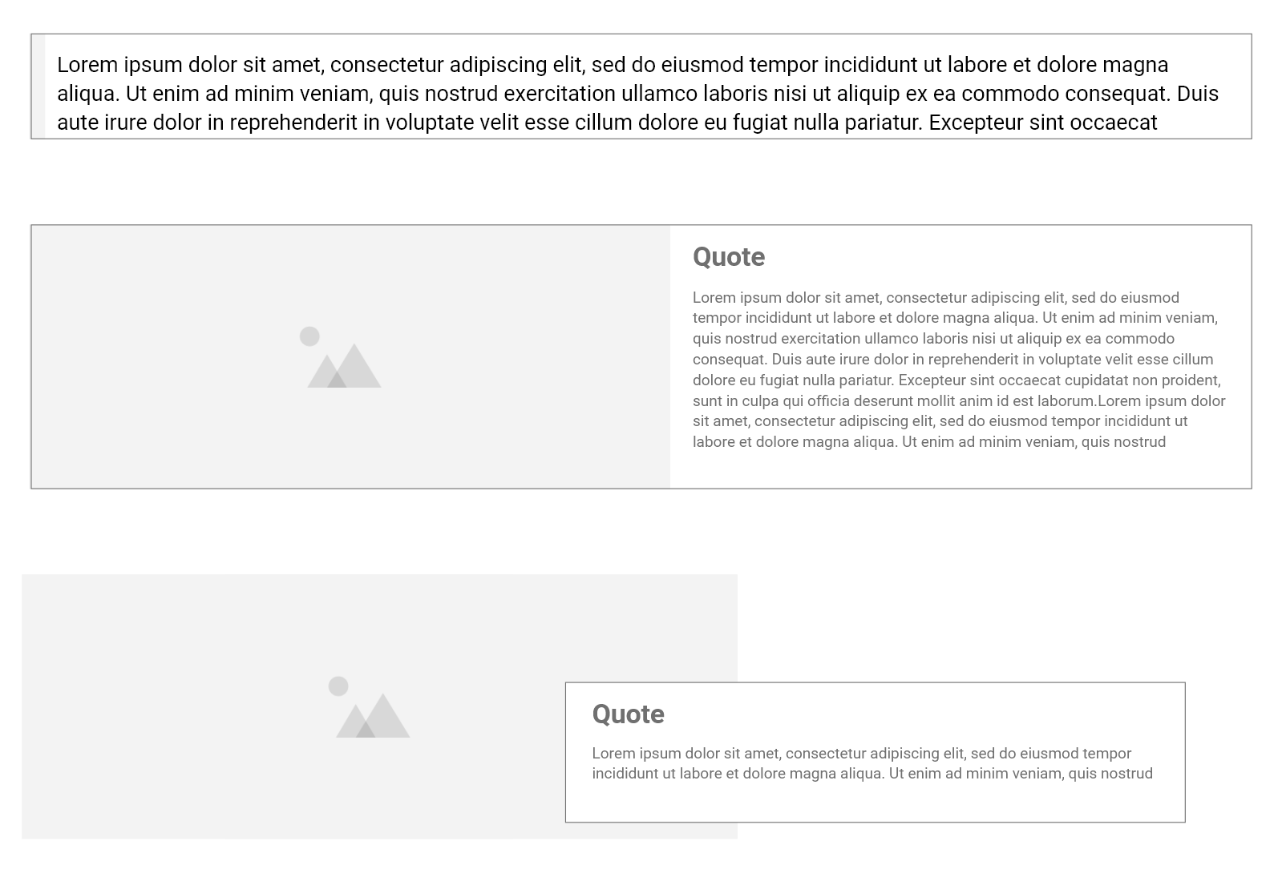
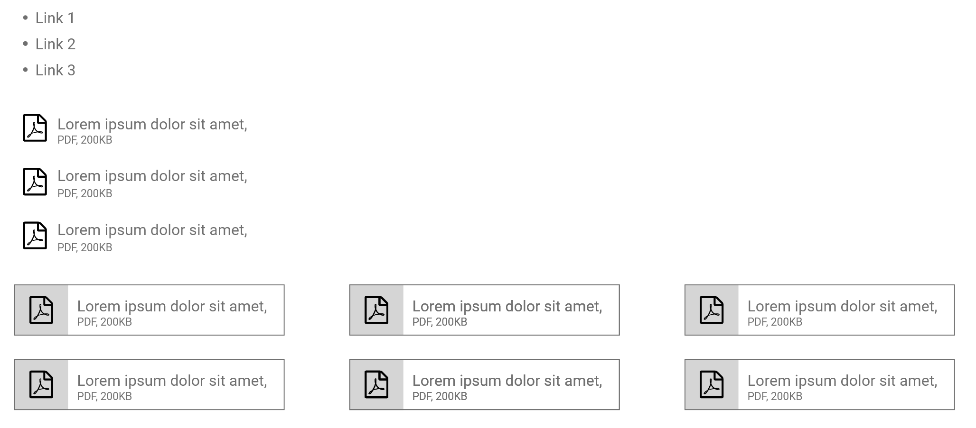
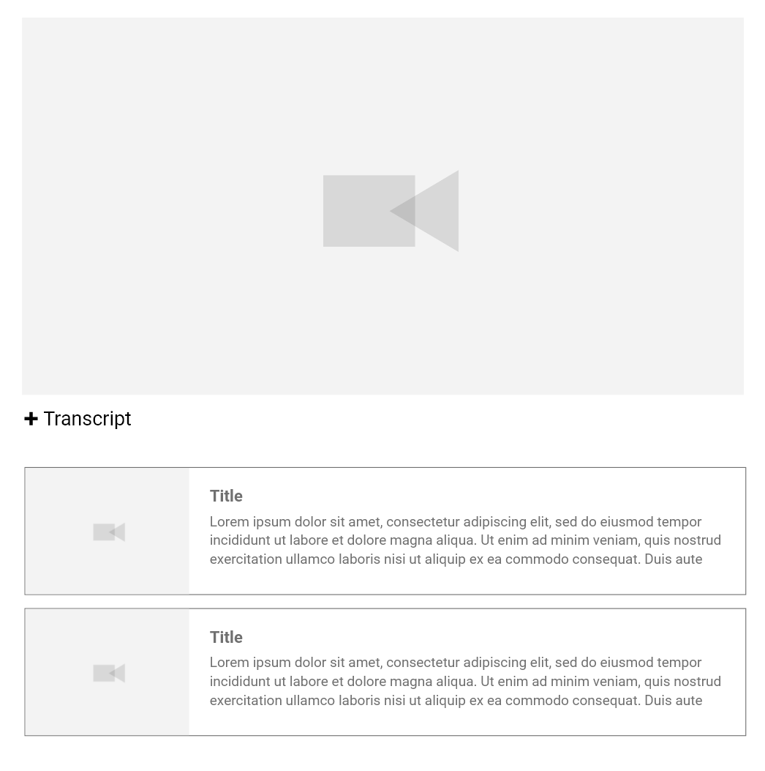
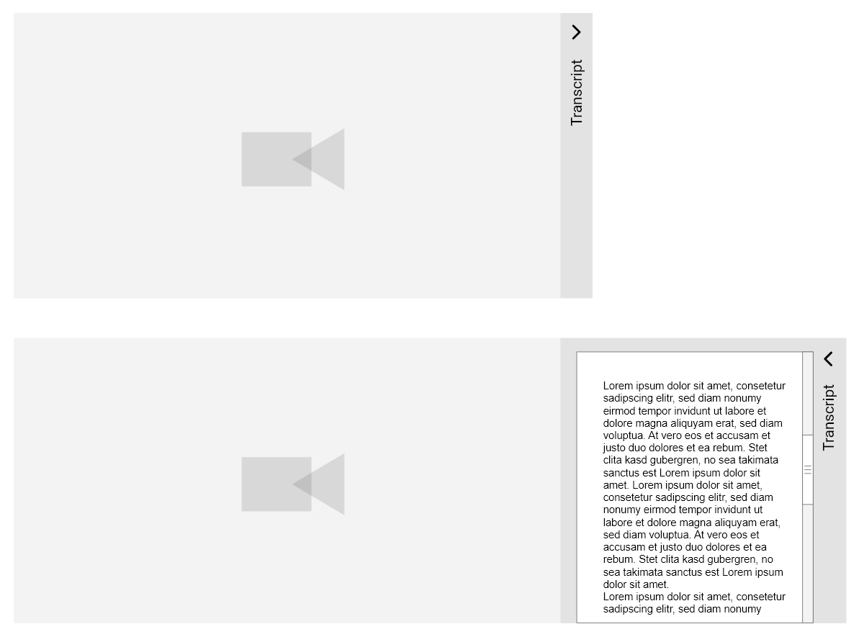
Content above and/or below tiles (optional)
Quotes
Key calls to action/buttons
Lists
Videos
Images

Slide 9
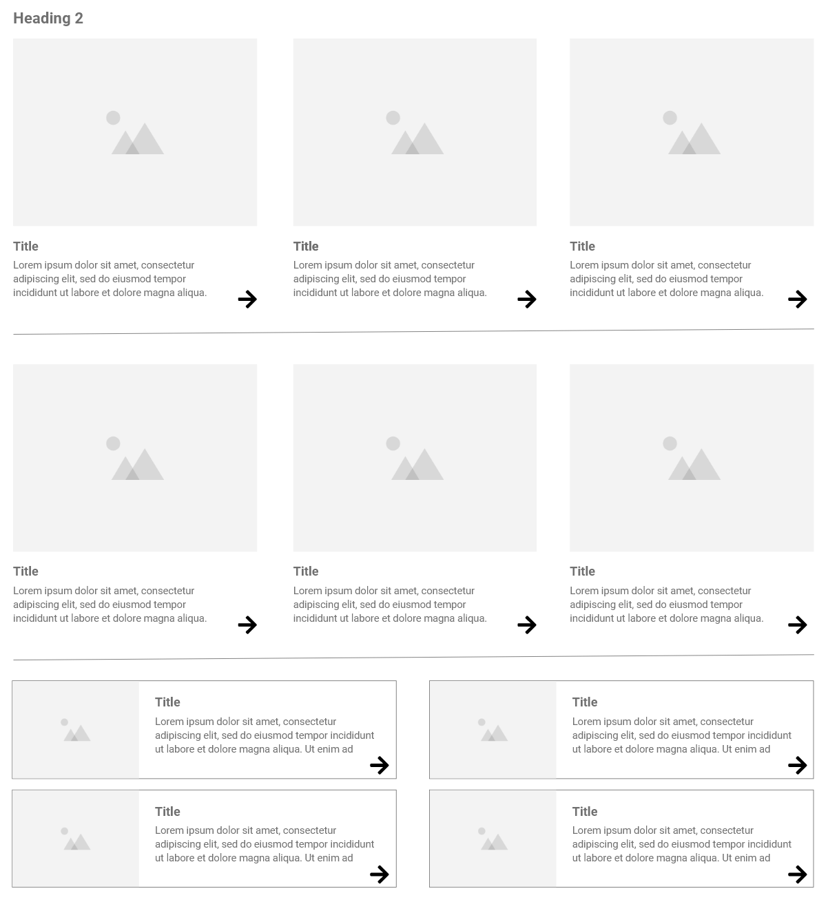
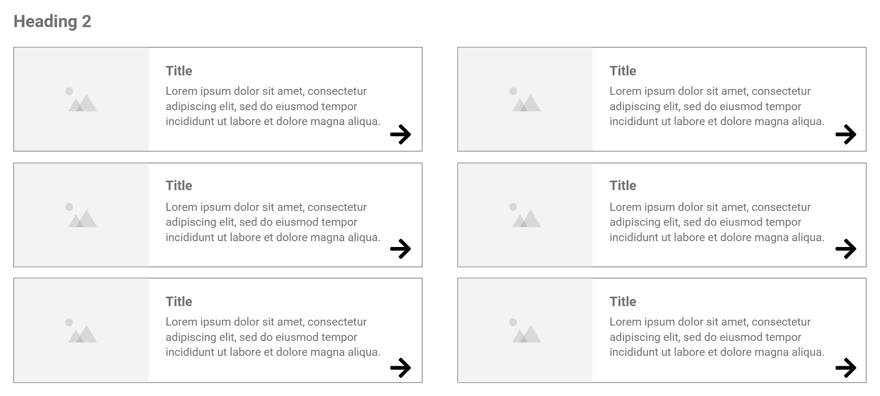
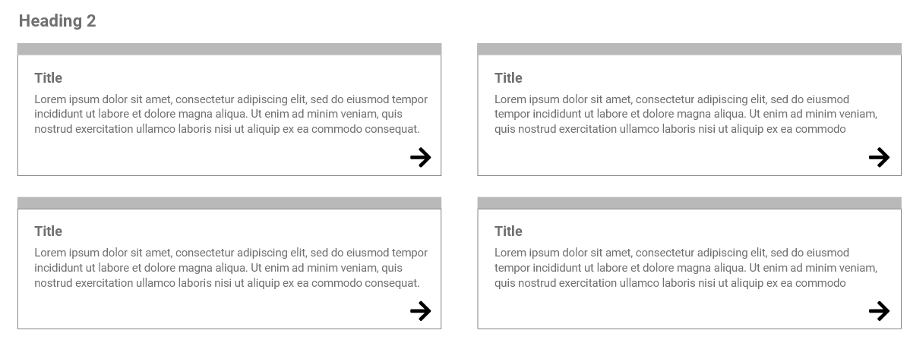
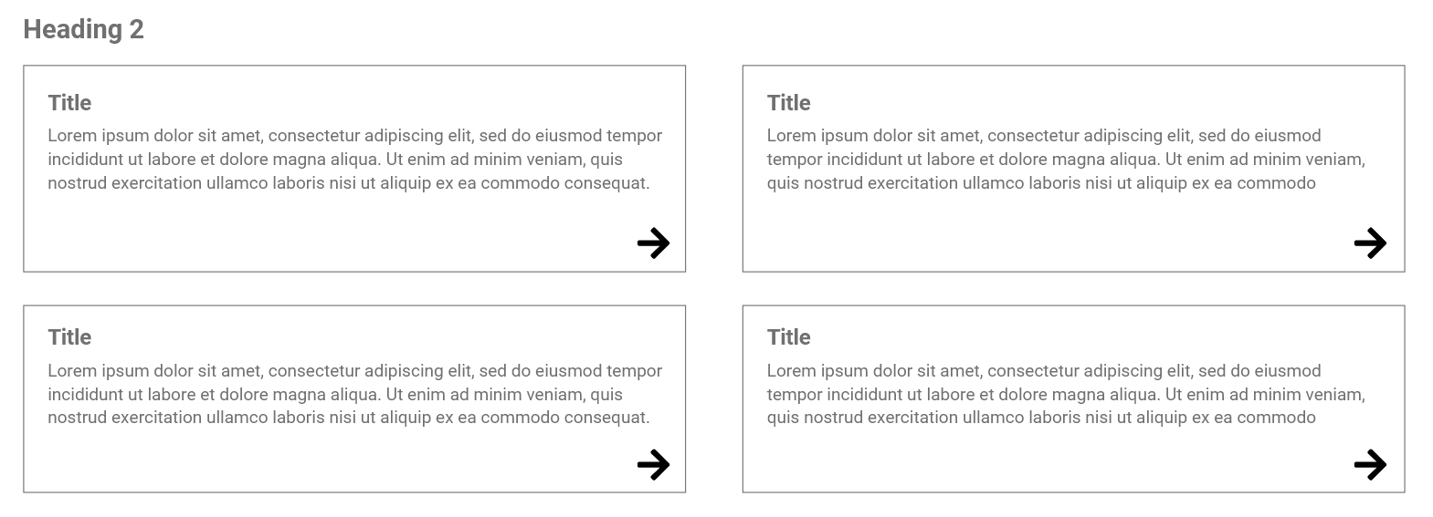
Child page tiles (mandatory)
For level 1, need an additional option showing level 3 links like EQI example
Level 1
Level 2
Level 3
Level 2 can also use stacked 3 column – maybe we can use design to give a little extra to the level 1 page but it not really necessary as the header makes it quite distinct
Is this level 3 / 4 /+?
Level 3/4
Maybe a final option for pages that you don’t want to present as a tile – for example, if the section had two pages for T&Cs and Licenses – may be option to present as list or title only?

Slide 10
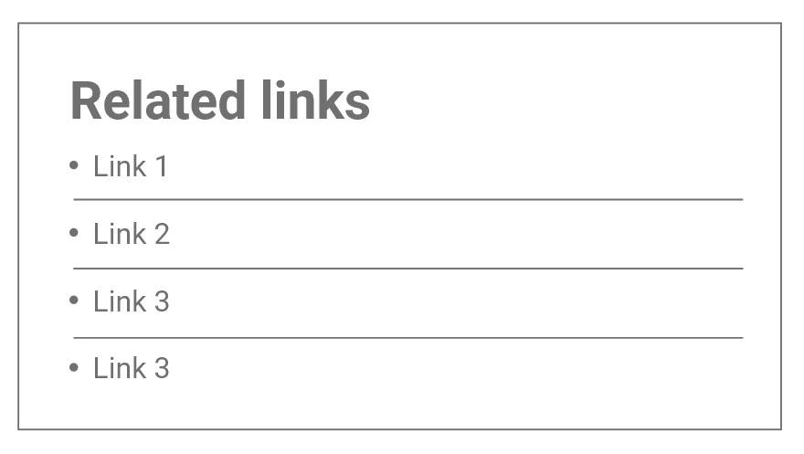
Related links (optional)
Will related links always be two column, or can they also be three column like the below? Maybe include in guidelines that they can use 2 or 3 column

Slide 11
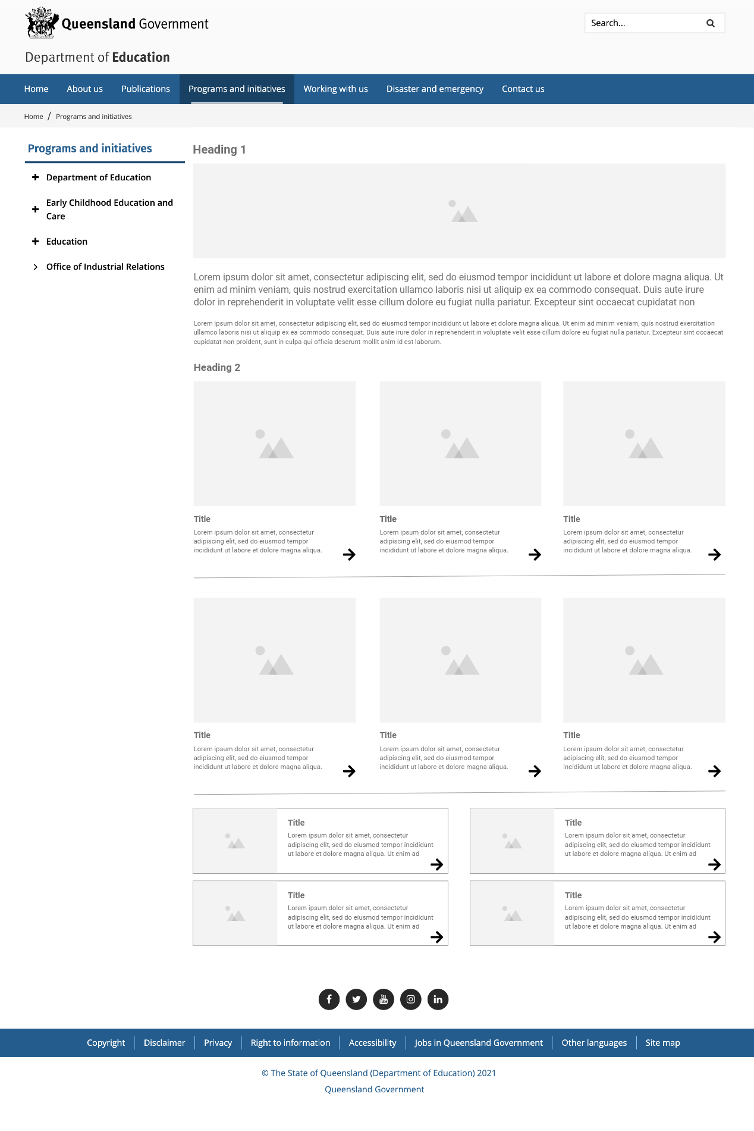
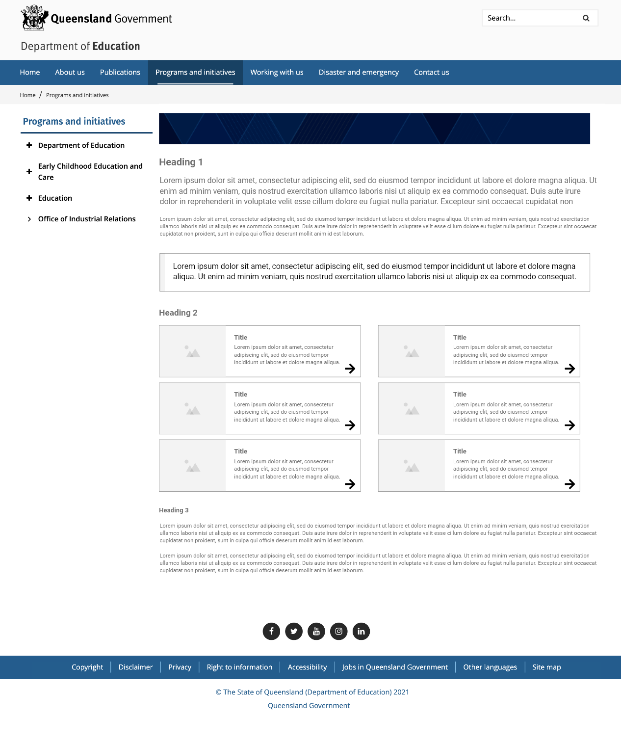
Level 1 page example
Level 2 page example

Slide 12
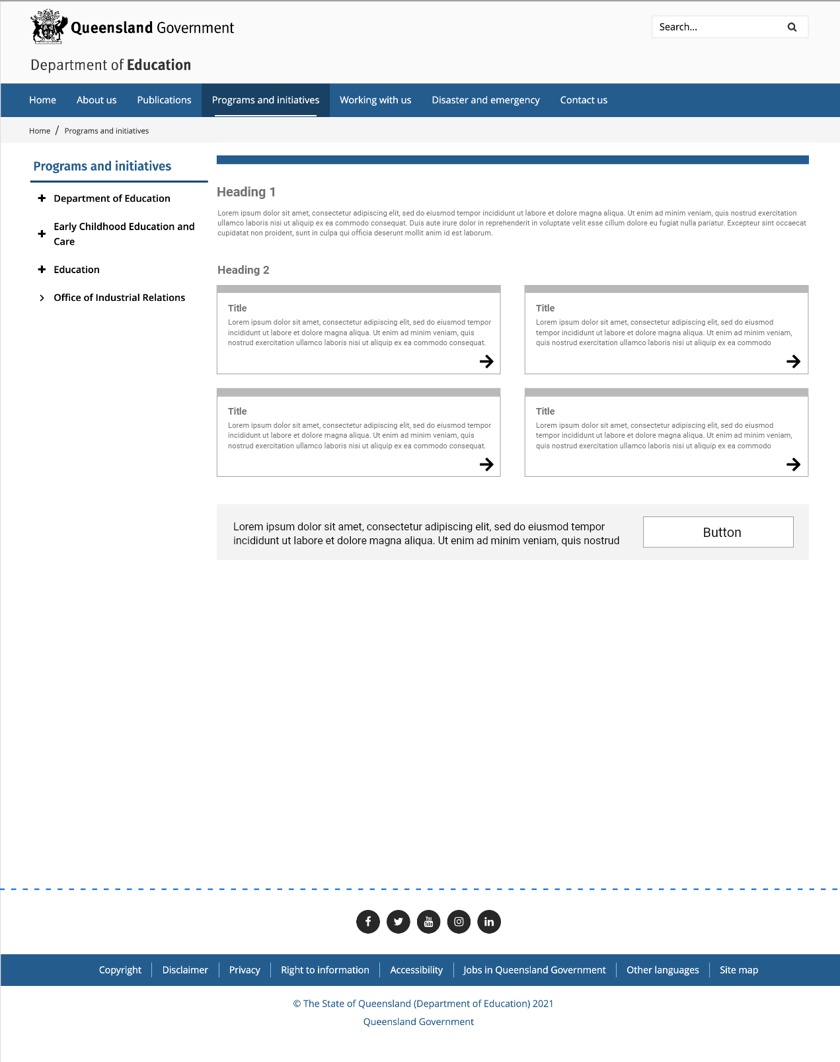
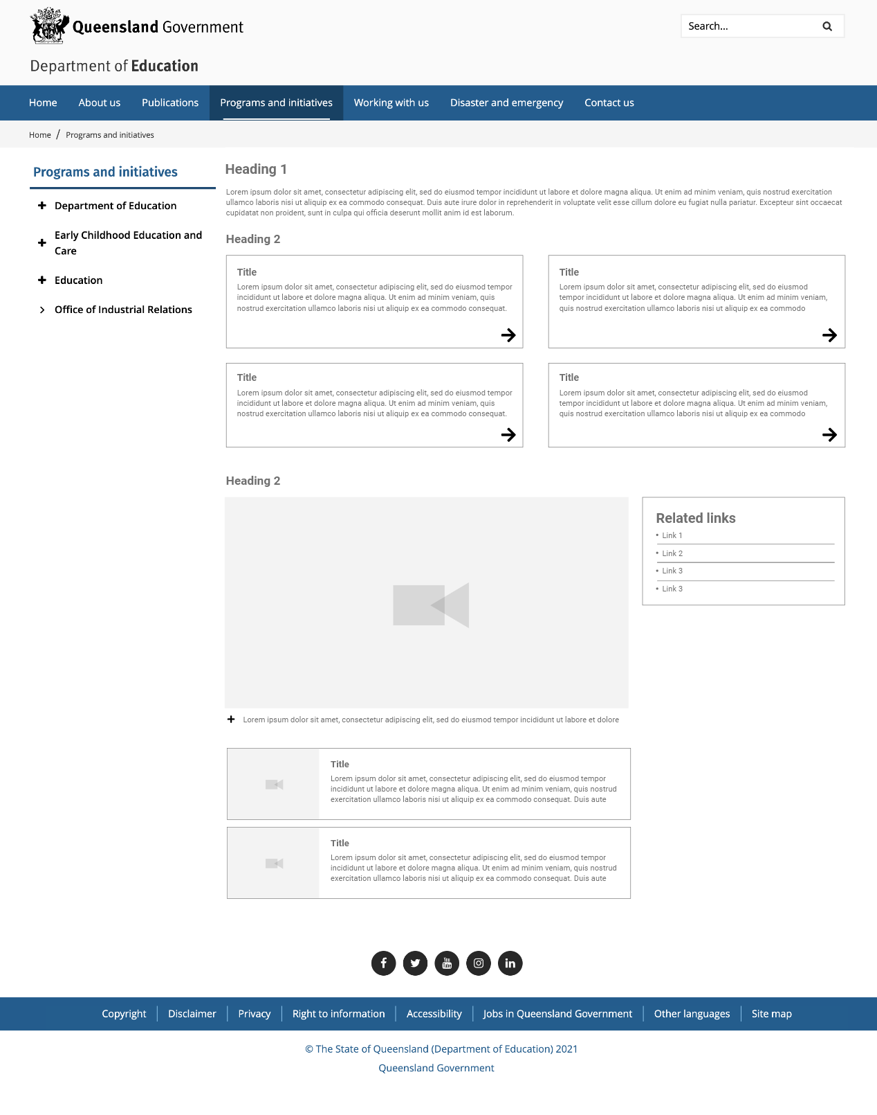
Level 3 page example
Level 4 page example

